Slide 1

A Tale of Two Stabilities: Longitudinal Dynamic Personality Networks
Emorie D. Beck and Joshua J. Jackson
Washington University in St. Louis
Notes:
Hello everyone, my name is Emorie Beck, and I’m going to talking about the longitudinal stability of ideographic time series networks in personality psychology.
Before I begin, I just want to say a couple of informal things. First, when I usually give this talk, I give it to a room full of personality psychologists. They know a lot about personality, but almost nothing about network science. So I talk a lot about networks and very little about personality. Here, I’m going to do the opposite.
Second, the impetus of this project is firmly rooted in personality, and there are some terms we use a little differently. When I say stability, I don’t mean the stability of parameter estimates or searching for narrow confidence intervals. In personality, we study dispositions, so the stability I will talk about is whether dispositions, conceived of as networks, show stability over time. Moreover, because this is over time, stability is part of the study of personality development.

Slide 2
Background | Methods | Temporal | Contemporaneous | Conclusions
Extraversion
Agreeableness
Conscientiousness
Neuroticism
Openness
DICTIONARY
Nomothetic
John, Naumann, & Soto, 2008; Cervone & Beck, 2017
Notes:
Love it or hate it, in American personality psychology, you can’t talk about dispositions without talking about personality structure. Moreover, when we say structure, we are typically thinking of defining it by the Big 5 (extraversion, agreeableness, conscientiousness, neuroticism, and openness to experience).
This structure is based on the lexical hypothesis, which states that if we want to understand the ways in which people differ from one another, we should look at how people describe one another. By factor analyzing how people respond to lists of adjectives, researchers have reliably extracted the Big 5 across languages, cultures, and ages. In a separate line of research, ratings of individuals’ behaviors converge on the same 5 factors.
These 5 factors have shaped the course of personality research for more than 50 years. This means that when we think about personality development, we are typically speaking of the development of these traits over time.

Slide 3
Background | Methods | Temporal | Contemporaneous | Conclusions
Extraversion
Agreeableness
Conscientiousness
Neuroticism
Openness
Nomothetic
John, Naumann, & Soto, 2008; Cervone & Beck, 2017
Notes:
The formulation of the factor analytic model, however, refers to the structure of personality in the population CLICK -- that is, it describes and explains between person differences. Thus, when we talk about personality development from this perspective, we are talking about broad population level changes.
CLICK

Slide 4
Background | Methods | Temporal | Contemporaneous | Conclusions
Extraversion
Agreeableness
Conscientiousness
Neuroticism
Openness
Idiographic
John, Naumann, & Soto, 2008; Cervone & Beck, 2017
Notes:
That does not mean, however, that the same structure applies to a single individual who may demonstrate unique trait structures, problematizing what it means to think of trait development using traditional personality measures.

Slide 5

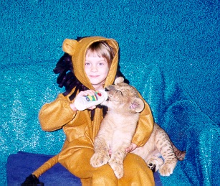


Personality Development
Background | Methods | Temporal | Contemporaneous | Conclusions
Roberts & Caspi, 2003
Notes:
When we think about personality at the individual level, we are typically thinking of ourselves. However, when you study personality development, you quickly realize that everyone has an opinion about personality and personality development. On the one hand, they see themselves as a very different, more mature person. On the other, they see threads of their past selves in who they are now.

Slide 6
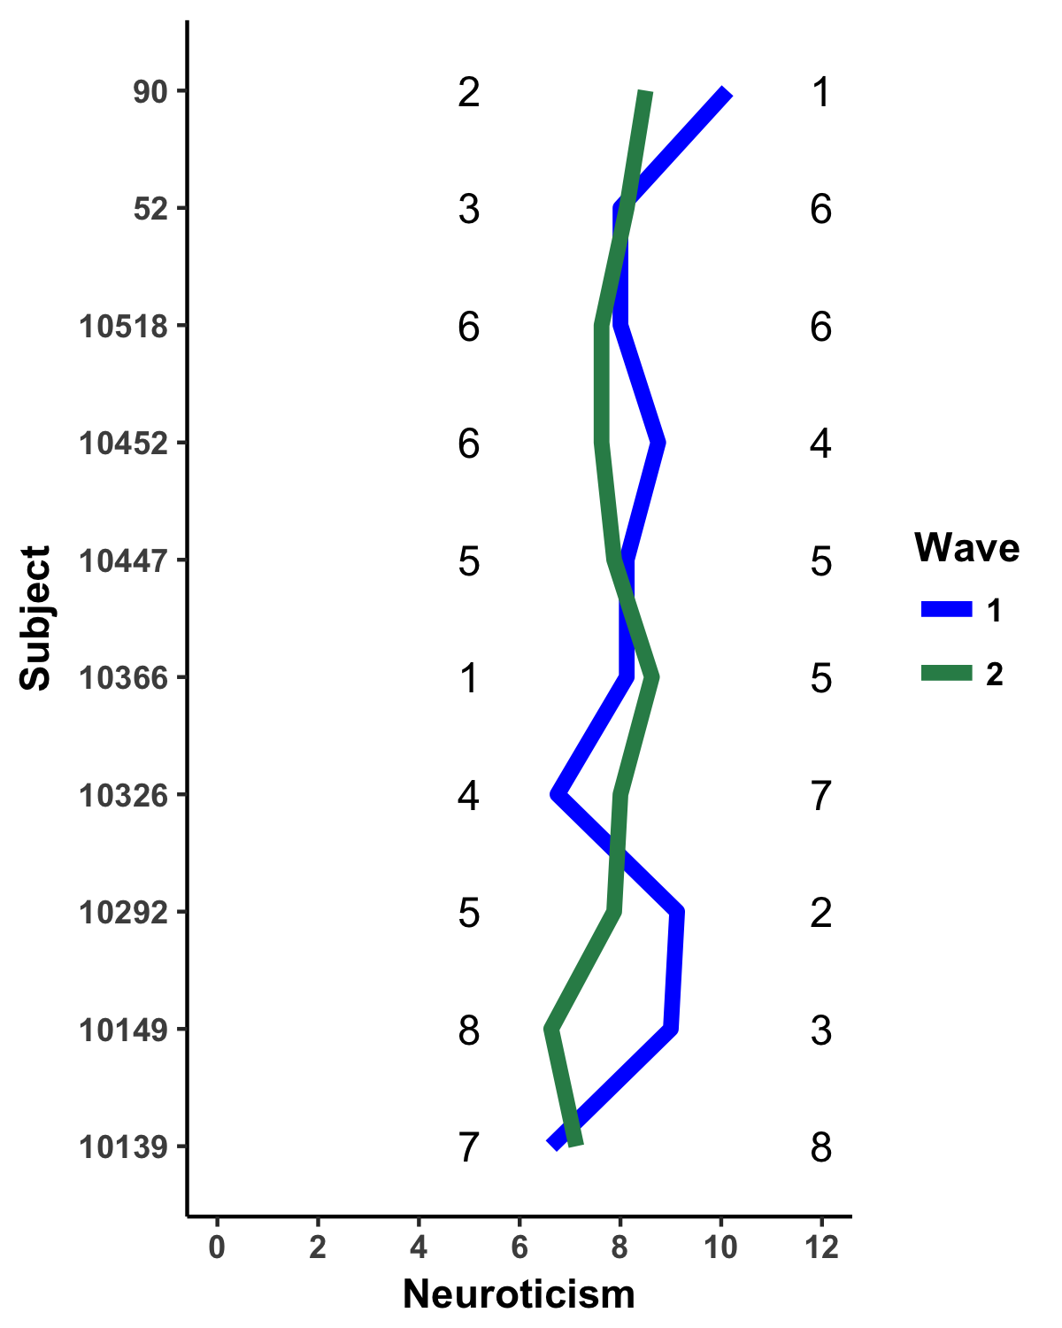
Personality Development
Background | Methods | Temporal | Contemporaneous | Conclusions
Typical Approaches to consistency:
Absolute change
Rank-order consistency
Ipsative consistency
Suggests that personality is relatively stable over time and exhibits normative changes
BUT there are individual differences in change
The Big 5
Extraversion
Agreeableness
Conscientiousness
Neuroticism
Openness to Experience
Caspi & Roberts (1990); Roberts et al. (2006); Mroczek & Spiro (2003)
Notes:
How do we empirically investigate continuity and change in personality? There are three main perspectives.
First, absolute change looks at individual or population level mean changes over time, shown here by the slopes of the lines, that represent individual changes in neuroticism over 2 years.
Second, by looking at rank order change, which indexes whether mean level change is systematic at the level of the population, as well as individual differences in change. That is, do people who are higher in neuroticism at wave 1 remain higher at wave 2? If yes, we should parallel lines when we plot ranks.
Third, by looking at ipsative or profile change, which indexes whether change is systematic at the level of a person. Basically, we look at a person’s profile of scores over time, and we see if they are parallel.
Research into these 3 kinds of stability using the Big 5 have shown that personality is rather stable over time, even across the whole life course.
However, there are also individual differences in the degree, direction, and type of change.

Slide 7
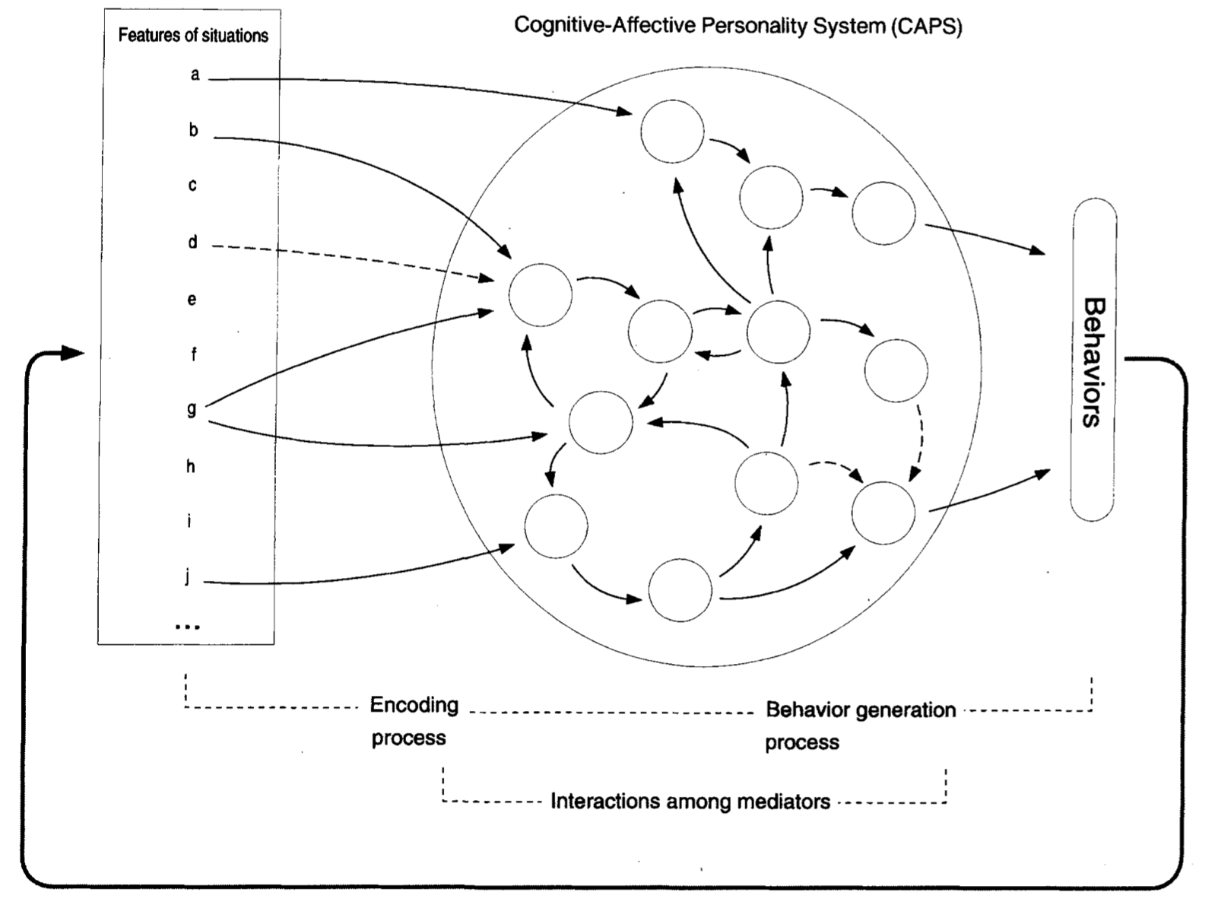
Personality Processes
Background | Methods | Temporal | Contemporaneous | Conclusions
Mischel & Shoda (1995)
Notes:
Individual differences beg the question of the processes underlying such change.
Mischel and Shoda’s cognitive affective personality system offers a possible explanation. According to their model, individuals actively interact with their environment. Individual differences are not just in behavior, but also in the if… then contingencies between psychological appraisals of situation features and cognitive and affective processes and tags of these features, which then generate behaviors. In other words, individuals may get to the same behaviors through many different paths, which suggests why behavioral (personality) change is not systematic across people.

Slide 8
Personality Processes
Background | Methods | Temporal | Contemporaneous | Conclusions
Experience Sampling Methods (ESM)
Mischel & Shoda (1995)
Notes:
Studying psychological processes of personality has remained difficult and limited. But recent advances in technology allow researchers to use more naturalistic measures that capture state, rather than trait, measures of dispositions. The most popular way of doing so is with experience sampling measures in which people respond to short surveys multiple times per day for a period of several days, weeks, or even months.

Slide 9
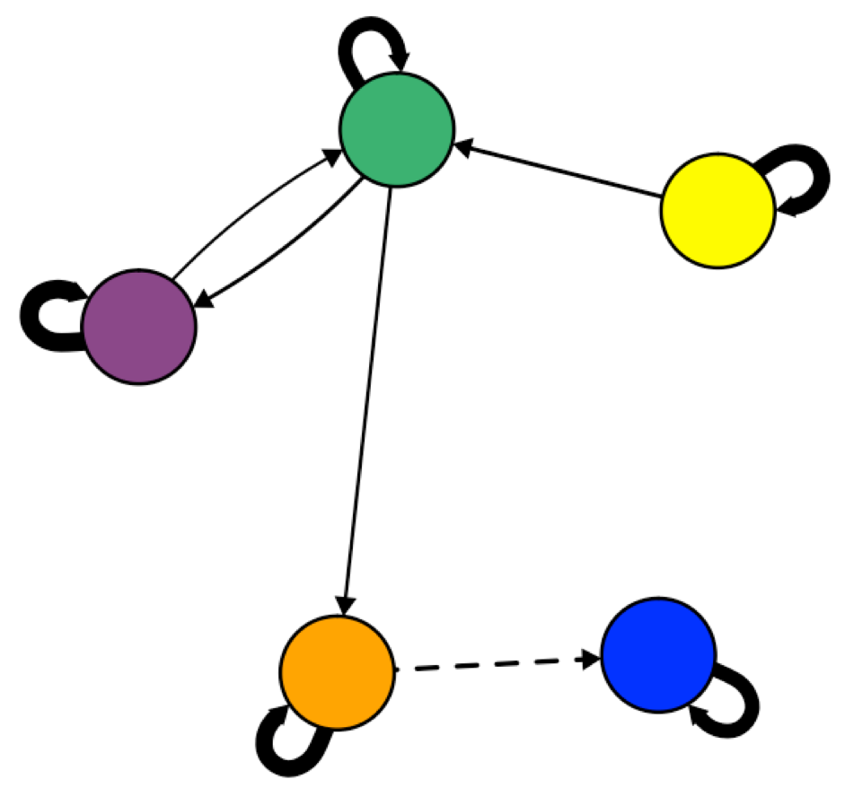
Background | Methods | Temporal | Contemporaneous | Conclusions
Idiographic
Notes:
Such data allows us to capture variability in psychological processes and behavior at the individual level that are missed with broad measures.
Moreover, when coupled with a network approach, ESM data can be used to create network models can for individual people, allowing for unique interdependencies among responses.
Such an approach has the advantage of allowing us to model personality closer to the level of a person. In other words, we can model unique relationships among the individuals self-reported observable and unobservable experiences, which may finally allow us to answer the question of whether ideographic assessments of personality do stack up to the power of nomothetic assessments.

Slide 10
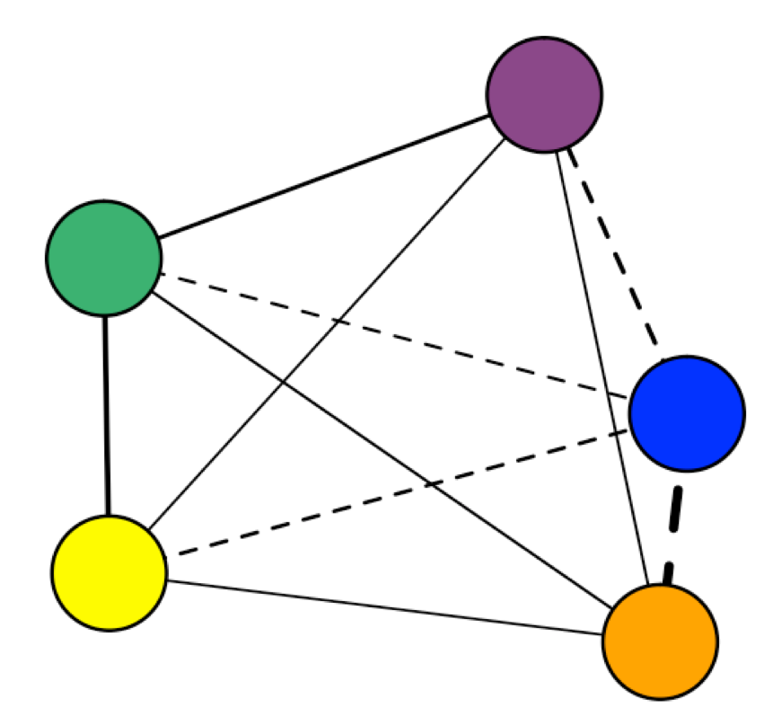
Background | Methods | Temporal | Contemporaneous | Conclusions
Concurrent behaviors:
While…
Contingent behaviors:
If… Then…
Within Time-Points: X_{i}←→Y_{i}
Between-Time Points: X_{i} → Y_{i+1}
Wild et al. (2010); Epskamp, Waldorp, Mõttus, & Borsboom, 2016)
Notes:
When using intensive repeated measures, such as the ESM data we will be discussing today, we can construct two networks for each subject, one undirected, contemporaneous network that models associations between indicators at any given time point. These are best thought of as “while” relationships, answering the question of what else the participant is likely experiencing or doing given another experience at the same time.
We can also construct a directed, temporal network that models associations between indicators across time points. These are best thought of as “if… then” temporal relationships, answering the question of what the participant was likely doing or feeling a few hours before or after a time point of interest.

Slide 11
Questions
Background | Methods | Temporal | Contemporaneous | Conclusions
How stable are networks of personality over time?
What are the structures of individual level personality networks?
Are there individual differences in idiographic personality networks?
Notes:
As I’ve outlined, networks in personality have great promise for providing new insights into psychological dynamics and processes and new lines of research. But before we can, in good faith, proceed with such research, we must first answer several basic connections about dynamic personality networks.
First, how stable are networks of personality over time? That is, how well are we separating signal and noise?
Second, what are the individual and group level personality network structures and how are they related?
Third, are there individual differences in the personality network? That is, how
make it clear that ID are at the idiographic level

Slide 12
Methods
Background | Methods | Temporal | Contemporaneous | Conclusions
2 years of ESM responses from the Personality and Intimate Relationships Study (PAIRS)
N = 372 Wash U undergrads, total assessments N = 17,715
Measures
9 items from the Big Five Inventory (BFI)
Procedure
4 assessments / day for 15 days
N1: Relaxed
N2: Depressed
N3: Worried
E1: Quiet
E2: Outgoing
A1: Rude
A2: Kind
C1: Lazy
C2: Reliable
Notes:
372 undergraduates at Washington University in St. Louis completed 4 ESM surveys per day for two weeks one year apart as a Part of the Personality and Intimate Relationships Study. In addition to other measures, they responded to a subset of 9 items from the BFI representing 4 of the Big 5, shown here at the right of the screen.

Slide 13
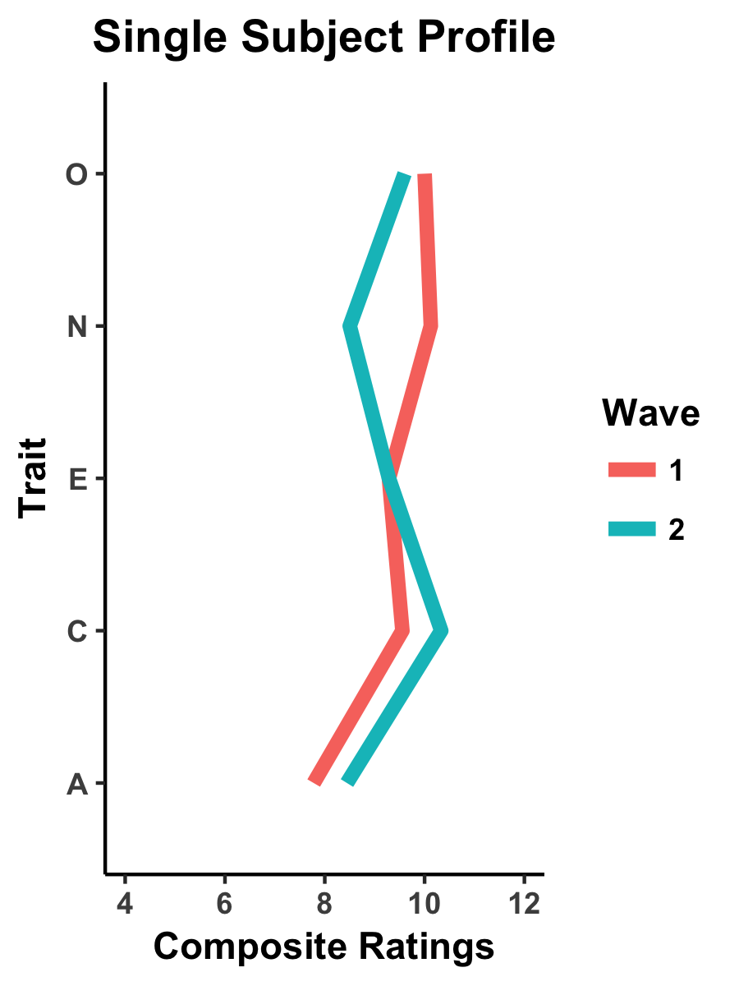
Stability
Idiographic
Results
Temporal
Contemporaneous
Ipsative Correlations
Absolute Change
Rank-Order Correlations
Edge Weights
Notes:
So just to outline how we are going to move through the results. We are going to be talking about idiographic stability, that is whether an individuals' personality, modeled as a network of behavioral and psychological responses, is consistent over two years.
To clarify, the nodes are the set of behaviors and emotions chosen because they are considered the “most representative” indicators of personality manifestations – that is, personality research tells us these are the most basic units of analysis. The edges represent within and across time-point patterns – that is, the tendency for behaviors and emotions to occur or to follow one another.
We will ask this question for both temporal and contemporaneous networks. Due to time constraints, we will look only at ipsative stability, asking whether the profile of edge weights are consistent over two years.
A quick note on the network construction. The idiographic personality networks were constructed using the 9 ESM BFI indicators. For each participant at each wave, we estimated a graphical vector autoregressive model and extracted regularized partial contemporaneous correlations and regularized partial directed temporal correlations. The partial contemporaneous and directed correlations made up the edge weights of each participants network. We used a graphicalLASSO regularization using the network search algorithm laid out by Wild and colleagues in 2010 and implemented in the R package graphicalVAR.
Finally, I want to emphasize that I do not propose that the we have solved personality – just the opposite. This project was designed to test the limitations both of the procedure for N = 1 psychological laid out by Wild and colleagues as well as the limitation of constraining the personality space based on between person models

Slide 14
+ 4 hr
Results
Individual Level Temporal Networks
Notes:
TRANSITION HERE TO WHY POPULATION NETWORKS ARE INTERESTING BUT WE ARE STILL OBSCURING VARIATION AT THE INDIVIDUAL LEVEL BY NOT EXAMINING UNIQUE ASSOCIATIONS AND INSTEAD LOOKING AT DEVIATIONS FROM POPULATION MEANS

Slide 15
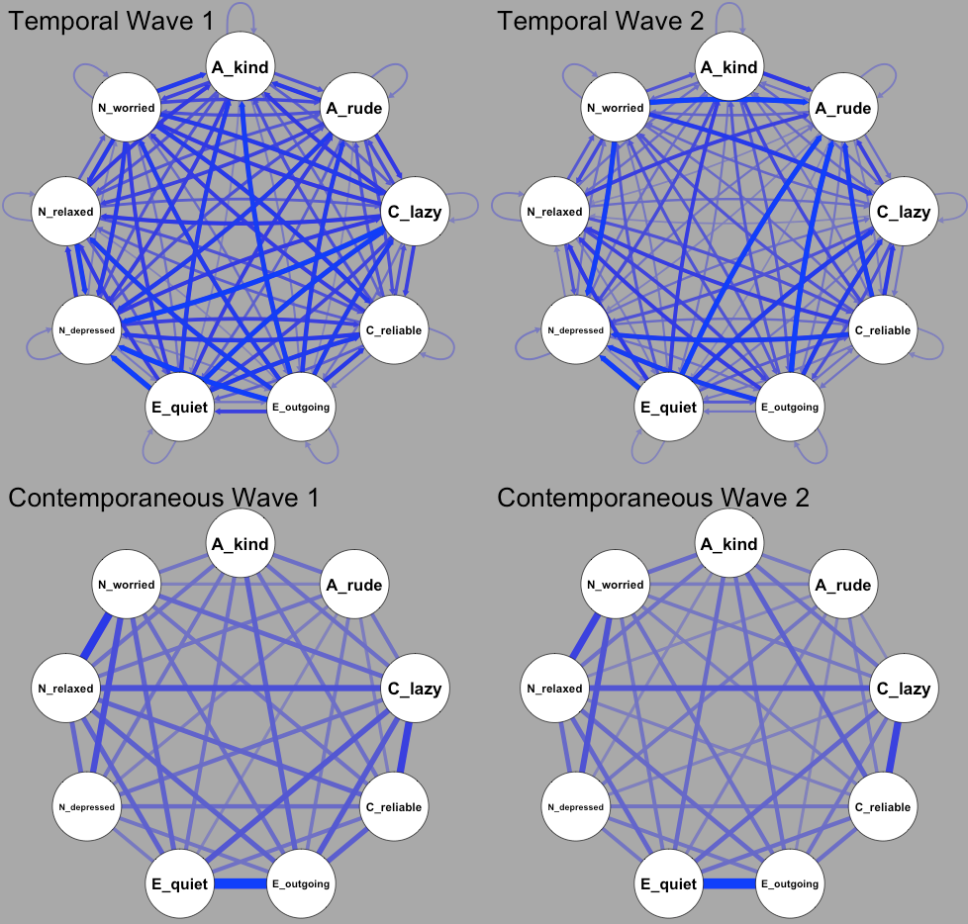
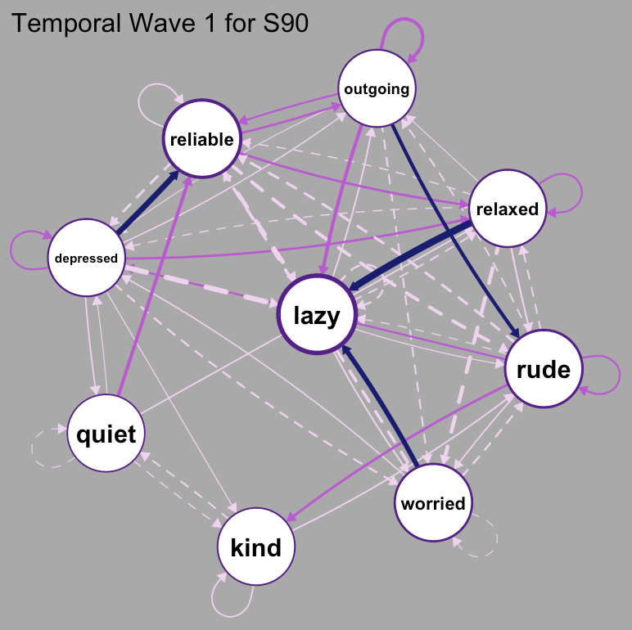
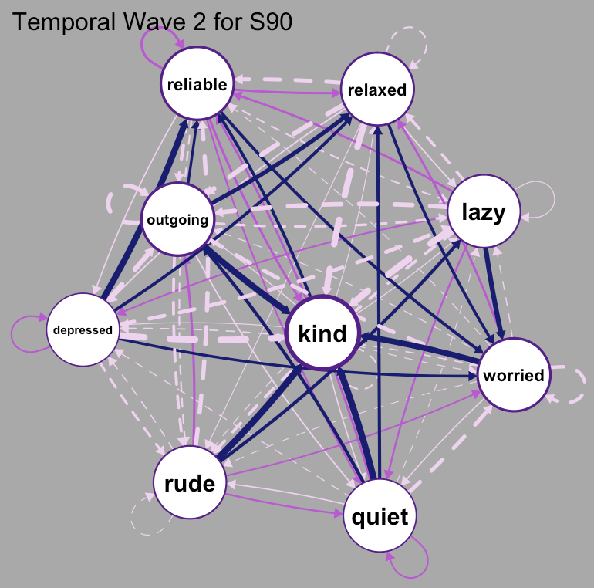
Individual Level Temporal Personality Network Stability
Background | Methods | Temporal | Contemporaneous | Conclusions
N1: Relaxed
N2: Depressed
N3: Worried
E1: Quiet
E2: Outgoing
A1: Rude
A2: Kind
C1: Lazy
C2: Reliable
Subject 90
Want to see more? https://emoriebeck.shinyapps.io/pairs_graphicalvar/
Notes:
First, are there individual differences in ideographic temporal personality networks?
These networks represent the standard deviations of each edge weight across people at both wave 1 (left) and wave 2 (right)
Second, given that we do see individual differences in edge weights, how much stability do we see over 2 years for each personf?
These are the wave 1 and wave 2 temporal personality networks for example subject 90. As you can see, the edge weights and arrangements of the networks differs greatly over 2 years.

Slide 16
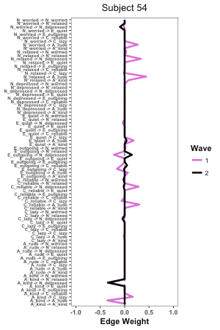
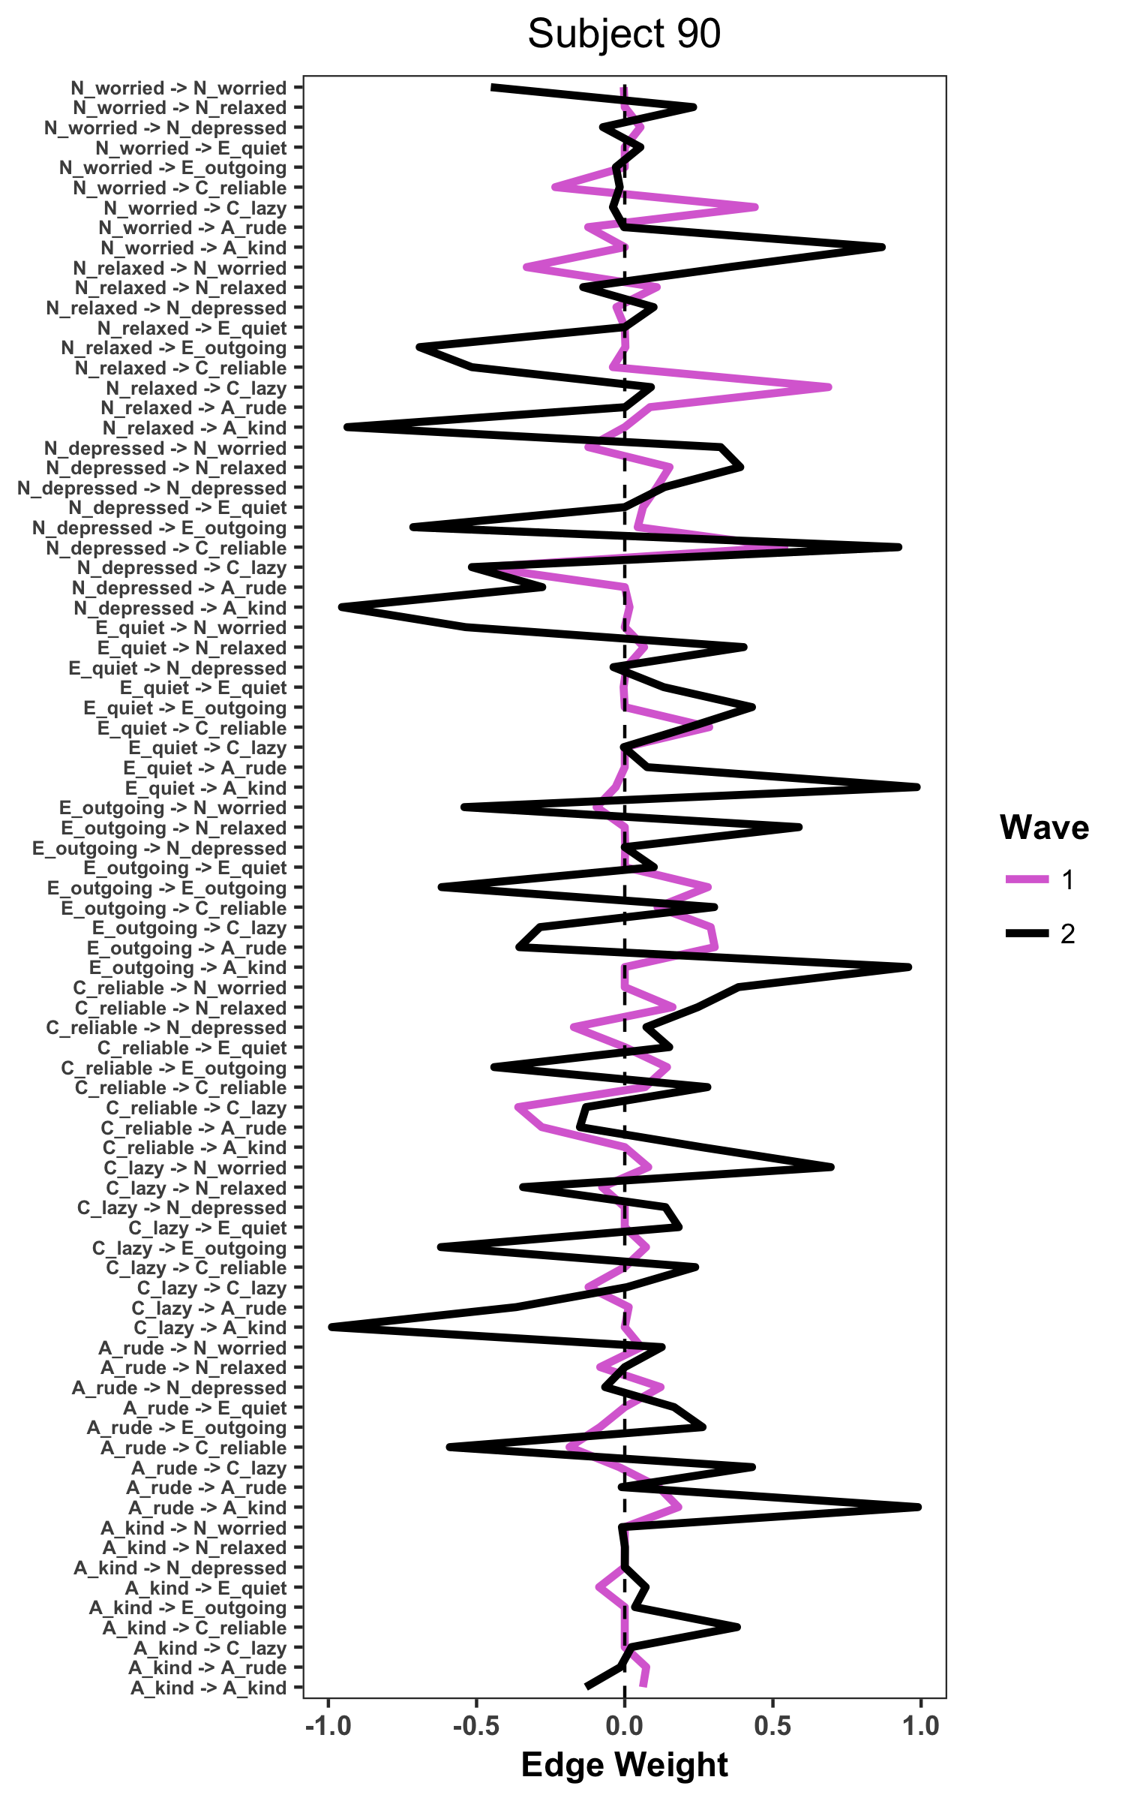
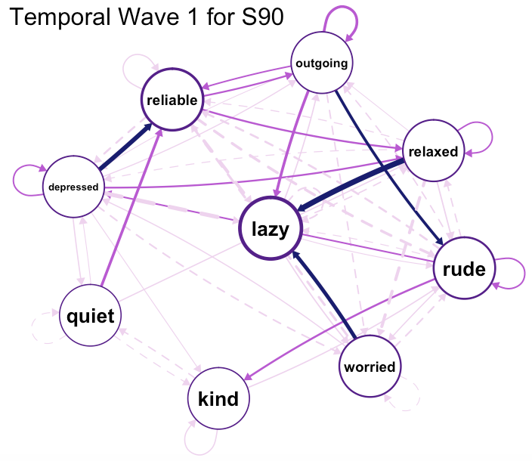
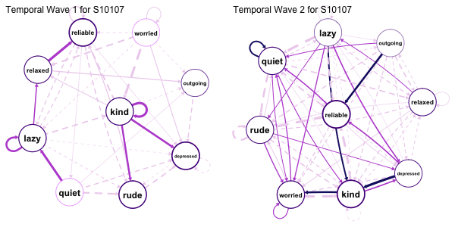
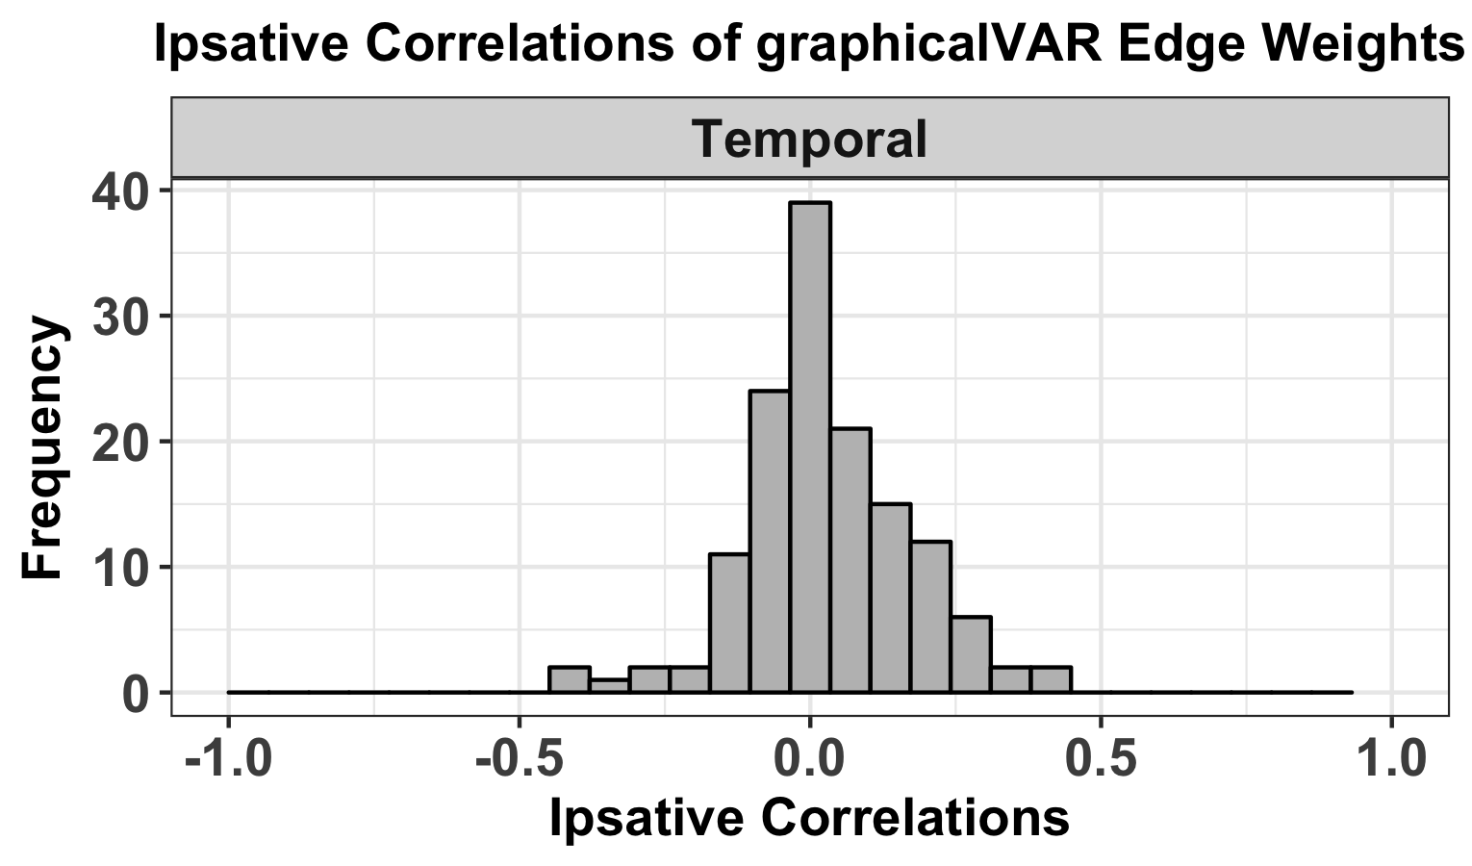
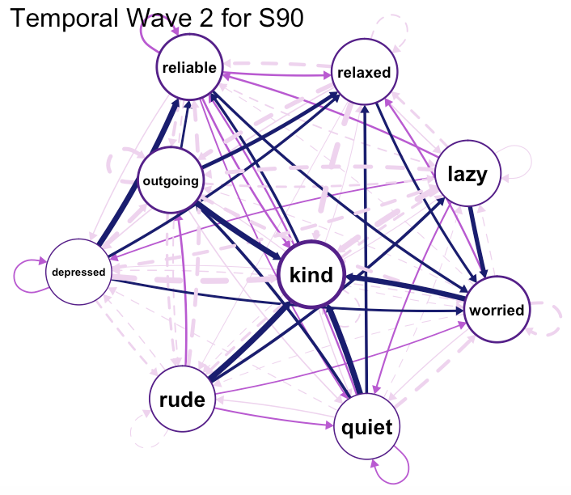
Individual Level Temporal Personality Network Stability
Background | Methods | Temporal | Contemporaneous | Conclusions
N1: Relaxed
N2: Depressed
N3: Worried
E1: Quiet
E2: Outgoing
A1: Rude
A2: Kind
C1: Lazy
C2: Reliable
Subject 90
r = .14
M = .03 (SD = .15)
Notes:
How different is it? I find it easiest to represent changes by looking at the profile of edge weights across both waves for each subject. So we have edges on the y axis, edge weights on the x, and the different lines represent the different waves. We see that there is a lot of change in Subject 90’s personality network over 2 years, with a profile correlation of about.14. Subject 90’s patterns of behavior over 4 hour intervals were quite different one year apart.
We can then do this for every subject and plot the distribution of profile correlations in a histogram.
By doing so, we see that the average stability converges on 0, meaning that overall patterns of behavior over 4 hour intervals were quite different one year apart. However, there were considerable individual differences in stability

Slide 17
NOW
Results
Individual Level Contemporaneous Networks
Notes:
We analyzed the two waves of responses separately. On the next two slides, I will show you first the group level structure and stability of the temporal personality networks. Then I will show you an example of the structure and stability of a single participant’s temporal personality structure and stability.

Slide 18
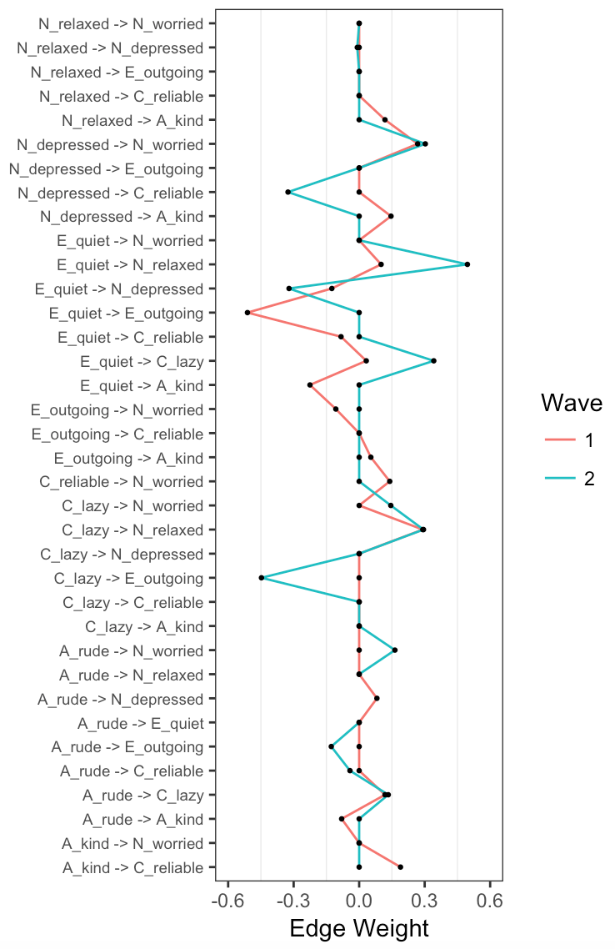
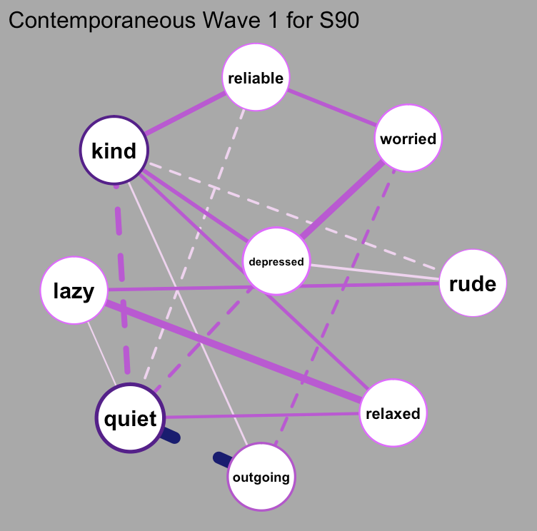
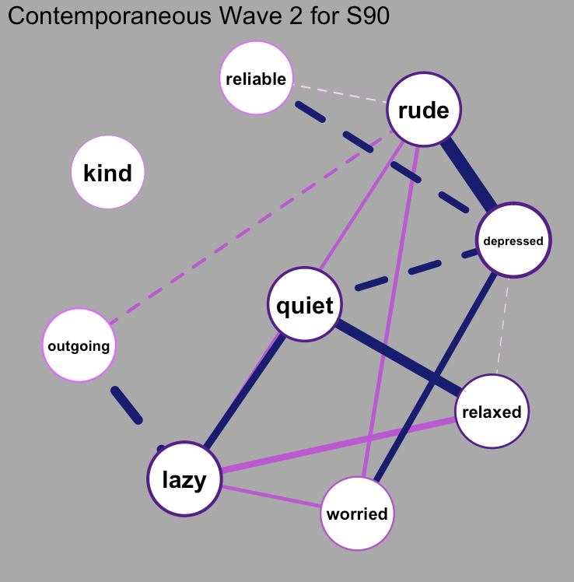
Individual Level Contemporaneous Personality Network Stability
Background | Methods | Temporal | Contemporaneous | Conclusions
N1: Relaxed
N2: Depressed
N3: Worried
E1: Quiet
E2: Outgoing
A1: Rude
A2: Kind
C1: Lazy
C2: Reliable
Subject 90
Want to see more? https://emoriebeck.shinyapps.io/pairs_graphicalvar/
Notes:
With the contemporaneous networks, we ask the same set of questions.
First, are there individual differences in ideographic contemporaneous personality networks?
These networks represent the standard deviations of each edge weight across people at both wave 1 (left) and wave 2 (right)
Second, given that we do see individual differences in network structure, how much stability do we see over 2 years for each person?
These are the wave 1 and wave 2 contemporaneous personality networks for example subject 90. As you can see, the structure of their network differs somewhat over 2 years.

Slide 19
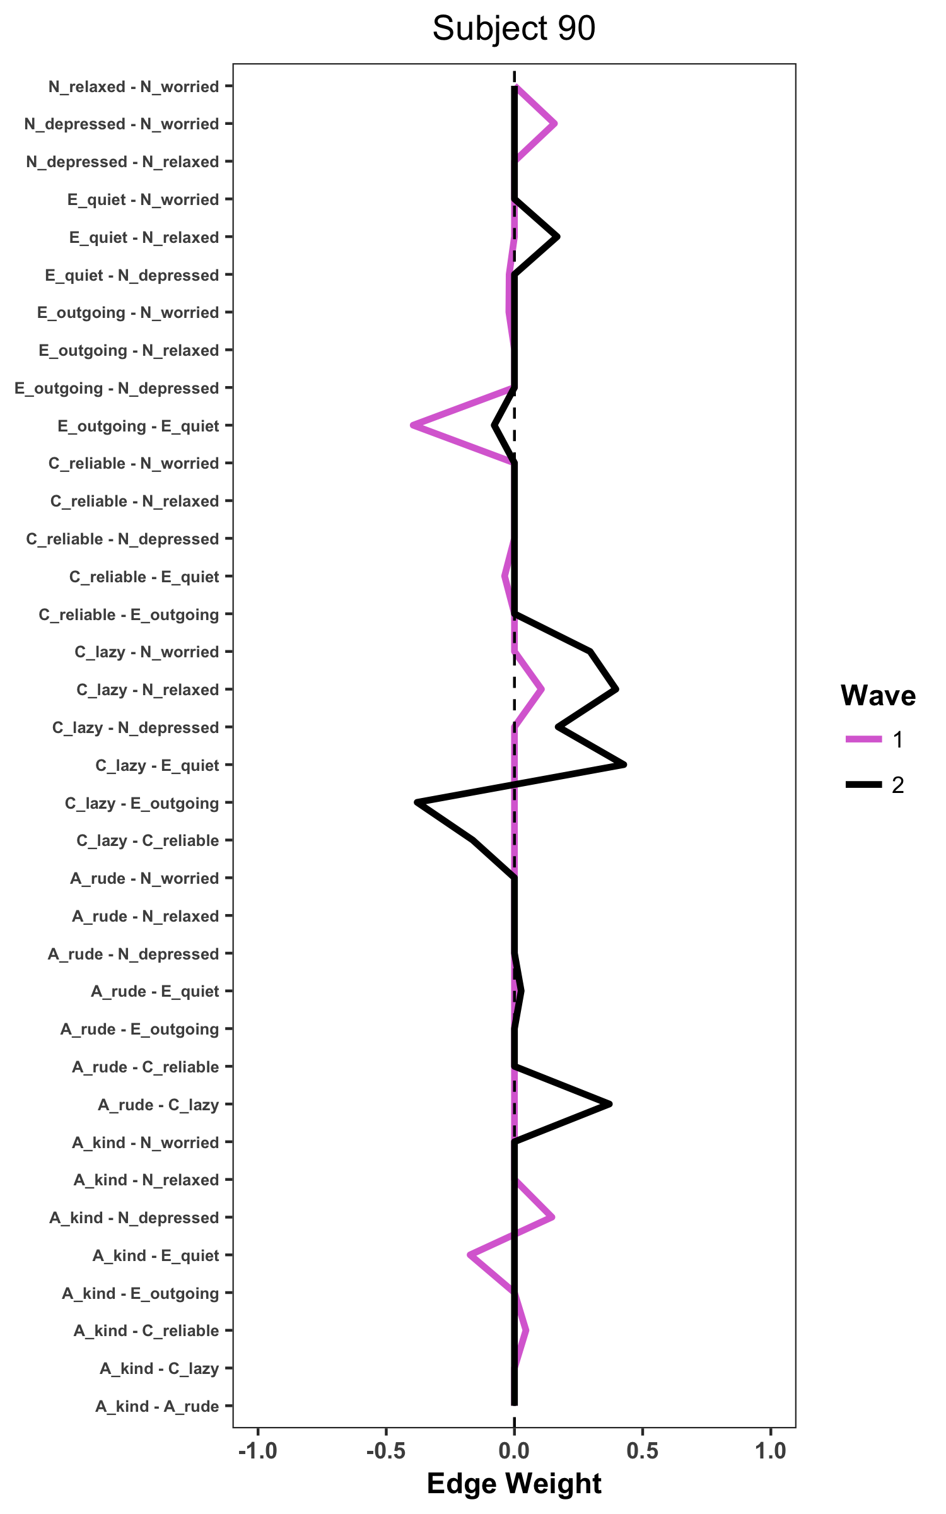
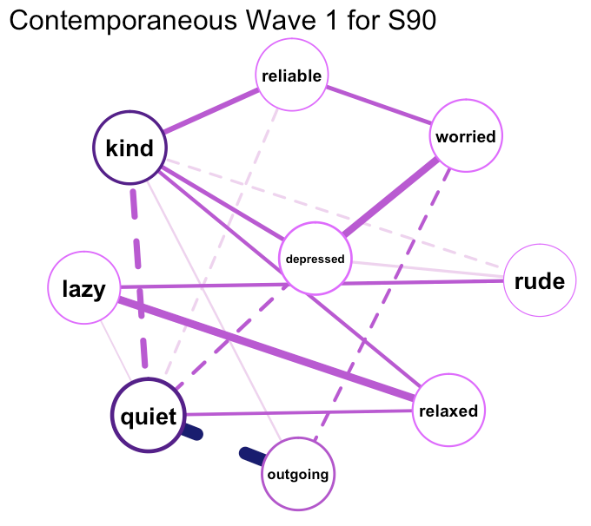
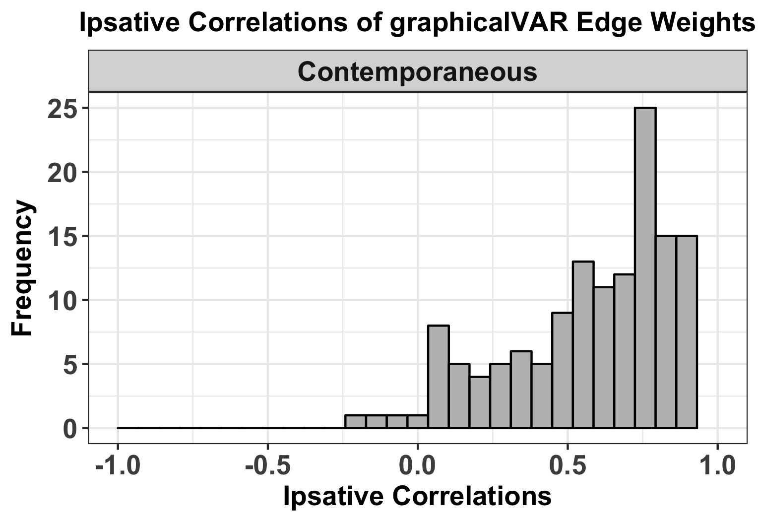
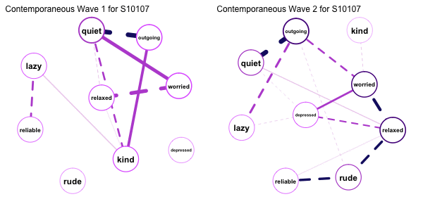
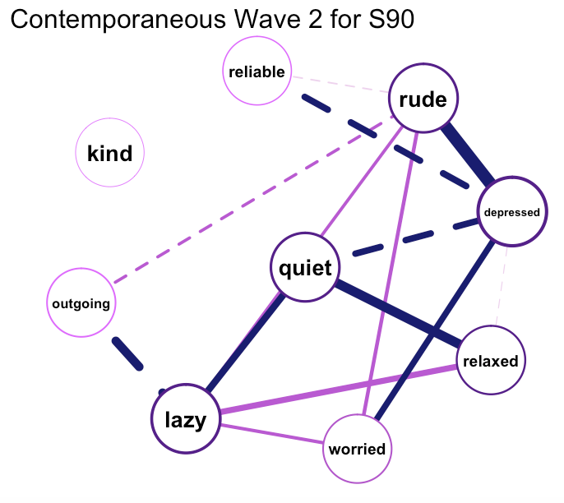
Background | Methods | Temporal | Contemporaneous | Conclusions
Individual Level Contemporaneous Personality Network Stability
N1: Relaxed
N2: Depressed
N3: Worried
E1: Quiet
E2: Outgoing
A1: Rude
A2: Kind
C1: Lazy
C2: Reliable
Subject 90
r = .34
M = .64 (SD = .41)
Notes:
How different is it? Again, I find it easiest to represent changes by looking at the profile of edge weights across both waves for each subject. So we have edges on the y axis, edge weights on the x, and the different lines represent the different waves. We see that there is a some change in Subject 90’s personality network over 2 years, with a profile correlation of about .32. Subject 90’s patterns of behavior over 4 hour intervals were slightly different but relatively consistent one year apart.
We can then do this for every subject and plot the distribution of profile correlations in a histogram.
By doing so, we see that the average stability converges much higher, with an average correlation of about .62, meaning that overall patterns of behavior within time points were quite similar one year apart. However, as with the temporal networks, there were considerable individual differences in stability. some are highly stable, and some are less table.
This has implications in terms of there is change that is being missed when we look at group level

Slide 20
Conclusions
Background | Methods | Temporal | Contemporaneous | Conclusions
Contemporaneous Idiographic Networks
strong ipsative, weak rank-order and absolute stability
People are changing systematically, but there are individual differences in the degree and direction of change as well as for which variables
Temporal Idiographic Networks
weak ipsative, rank-order, and absolute stability
People are changing, not systematically, and not in a particular direction
Notes:
Although we didn’t have time to talk about rank order and absolute change, I will briefly mention those patterns as we conclude.
Across two years, we see that contemporaneous ideographic networks show strong Ipsative, weak rank-order, and weak absolute stability. That is, people are changing systematically, but there are individual differences in the degree and direction of change as well as for which variables.
However, across two years, we see that temporal ideographic networks show weak ipsative, weak rank-order, and weak absolute stability. People are changing, not systematically, and not in a particular direction

Slide 21
Conclusions
Background | Methods | Temporal | Contemporaneous | Conclusions
We can now fit idiographic personality networks
The present results represent of subset of results but there are many more network properties
In this sample, other network properties (density, centrality) were more stable.
Unclear whether lack of stability represents lack of predictive power or measurement issues
Notes:
We can now fit ideographic personality networks. In personality, researchers have been calling for more ideographic, person-centered approaches to personality since the days of Gordon Allport.
Today, I presented only the stability of edge weights in temporal and contemporaneous networks
But there are many other network properties, which tended to be more stable across the two waves of the study.
At present, it is unclear whether the lack of stability in the temporal networks indicates that there is no stability across two years in behavioral sequences or whether the considerable measurement and analytic issues we faced are responsible. If there is no stability, we expect this is because college students’ schedules tend to change greatly from year to year, which will likely impact their behavioral sequences when measured four hours apart. To the second, I believe that we used too few indicators, too coarse of an interval between measurements, and had too few responses from many of the participants to estimate an ideographic network with enough power.
Despite this, we do see consistency at the level of contemporaneous ideographic networks as well as network properties of both temporal and contemporaneous networks.

Slide 22
Limitations
Background | Methods | Temporal | Contemporaneous | Conclusions
Intercepts
Measurement Interval
Too few variables
Parameter stability uncertain
Absolute Change
Notes:
Intercepts: no framework for unifying mean level differences as well as differences in patterns
Measurement Interval: lack of stability in temporal networks may reflect coarse gap between ESM assessments
Too few variables: Cannot ask or answer questions about Big 5 structure of dynamic, time-series networks
Parameter stability uncertain: Bootstrapping methods for time-series networks still in development
Absolute Change: Not meaningful with two time points and a 1 year gap

Slide 23
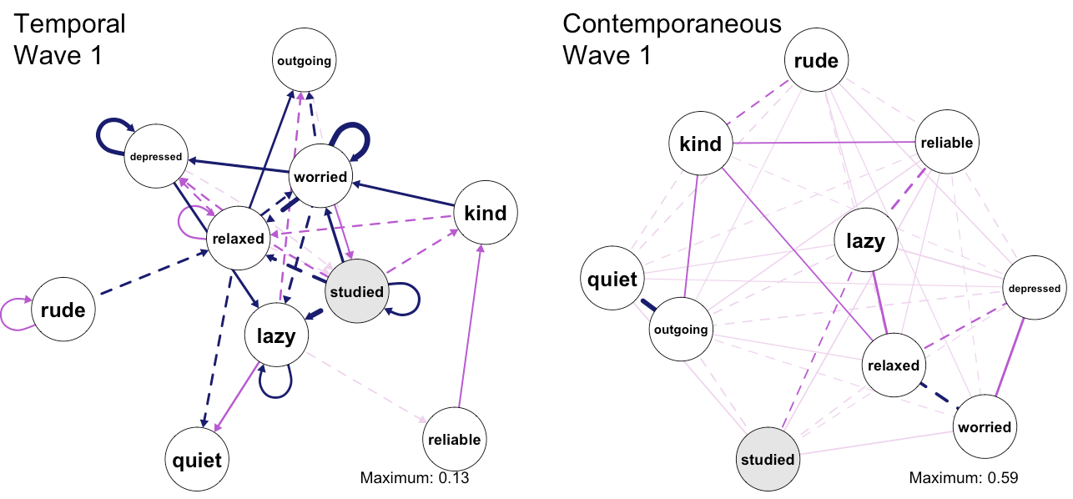
Future Directions
Background | Methods | Temporal | Contemporaneous | Conclusions
Predictive Networks
Modeling personality and momentary behavior
Using idiographic networks to predict long-term outcomes
Personality Network Development Across the Lifespan
Idiographic Networks and Personality Change
Notes:
In sum, group level networks show strong stability over time and partially mirror the Big 5 structure, while individual networks show less stability over time and diverge from the Big 5 structure. Thank you.
Get the within-semester associations for subjects who have enough measurement points

Slide 24
Questions?
Background | Methods | Temporal | Contemporaneous | Conclusions
Special Thanks to:
Josh Jackson
The PMaD Lab
(And the people who brought us PAIRS data)
R Code Available at:
https://goo.gl/lC7PDh
Interactive Idiographic Plots Available at:
http://tinyurl.com/pairsnetworks
Notes:
In sum, group level networks show strong stability over time and partially mirror the Big 5 structure, while individual networks show less stability over time and diverge from the Big 5 structure. Thank you.

Slide 25
Background | Methods | Temporal | Contemporaneous | Conclusions
Selected References
Bringmann, L. F., Pe, M. L., Vissers, N., Ceulemans, E., Borsboom, D., Vanpaemel, W., ... & Kuppens, P. (2016). Assessing temporal emotion dynamics using networks. Assessment, 23(4), 425-435.
Bringmann, L. F., Vissers, N., Wichers, M., Geschwind, N., Kuppens, P., Peeters, F., ... & Tuerlinckx, F. (2013). A network approach to psychopathology: new insights into clinical longitudinal data. PloS one, 8(4), e60188.
Costantini, G., Epskamp, S., Borsboom, D., Perugini, M., Mõttus, R., Waldorp, L. J., & Cramer, A. O. (2015). State of the aRt personality research: A tutorial on network analysis of personality data in R. Journal of Research in Personality, 54, 13-29.
Costantini, G., & Perugini, M. (2016). The network of conscientiousness. Journal of Research in Personality, 65, 68-88.
Epskamp, S., & Fried, E. I. (2016). A Primer on estimating regularized psychological networks. arXiv preprint arXiv:1607.01367.
Epskamp, S., Waldorp, L. J., Mõttus, R., & Borsboom, D. (2016). Discovering Psychological Dynamics: The Gaussian Graphical Model in Cross-sectional and Time-series Data. arXiv preprint arXiv:1609.04156.
Schmittmann, V. D., Cramer, A. O., Waldorp, L. J., Epskamp, S., Kievit, R. A., & Borsboom, D. (2013). Deconstructing the construct: A network perspective on psychological phenomena. New ideas in psychology, 31(1), 43-53.
R Packages:
qgraph
igraph
mlVAR
graphicalVAR
dplyr
tidyr
purrr (for many, many idiographic models)
Notes:
In sum, group level networks show strong stability over time and partially mirror the Big 5 structure, while individual networks show less stability over time and diverge from the Big 5 structure. Thank you.

